Slide 1


CoStar Awards 2025
Winners social media toolkit

Slide 2


How to use this toolkit
Congratulations on being named a 2025 CoStar Awards winner! The CoStar Awards recognise UK commercial property agencies for their exceptional accomplishments and hard work.
Over the next slide, you’ll see some pre-constructed posts for social media that’ll help you celebrate your agency’s success. Please also consider sharing photos or selfies with the award using the official hashtag #CoStarAwards.

Slide 3
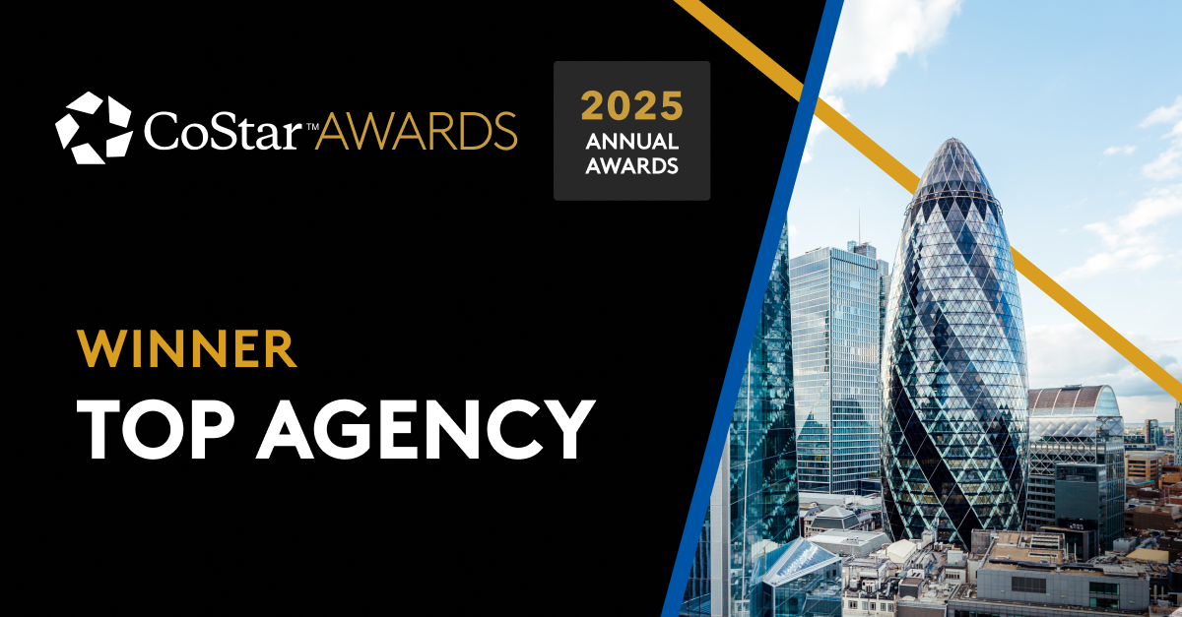
CoStar Awards 2025 winners
Suggested text for top agencies to use on LinkedIn, Facebook, Twitter/X and Instagram
Option 1:
We’re honoured to have been chosen by @CoStar as a #CoStarAwards winner in the (INSERT YOUR MARKET) market.
Learn more about the CoStar Awards:
https://www.costarawards.co.uk/winners/
Option 2:
(INSERT AGENCY NAME) are #CoStarAwards winners for our 2024 deals in the (INSERT YOUR MARKET) market. Thanks @CoStar for the recognition!
Learn more about the CoStar Awards:
https://www.costarawards.co.uk/winners/
Option 3:
We’re excited to announce that we have been recognised by @CoStar as a #CoStarAwards winner in the (INSERT YOUR MARKET) market.
Learn more about the CoStar Awards:
https://www.costarawards.co.uk/winners/

